Slide 1

RUNGTA COLLEGE OF DENTAL SCIENCES & RESEARCH
TITLE OF THE TOPIC- SURGICAL ORTHODONTICS
DEPARTMENT OF ORTHODONTICS AND DENTOFACIAL ORTHOPAEDICS

Slide 2
Specific learning Objectives
CORE AREAS | DOMAIN | CATEGORY
INTRODUCTION | AFFECTIVE | DESIRE TO KNOW
Minor Surgery | AFFECTIVE | DESIRE TO KNOW
Frenectomy | PSYCHOMOTOR | NICE TO KNOW
Removal of supernumerary teeth & odontomes | PSYCHOMOTOR | MUST KNOW
Surgical Exposure of Impacted Teeth | PSYCHOMOTOR | MUST KNOW
Corticotomy | PSYCHOMOTOR | MUST KNOW
Osteotomy for RME | PSYCHOMOTOR | NICE TO KNOW

Slide 3
CONTENTS
PART I
Introduction
Minor Surgical Procedures
1. Frenectomy
2. Pericision
3. Extractions
Removal of supernumerary teeth and odontomes
4. Surgical exposure of impacted tooth
5. Corticotomy
6. Osteotomy for RME
7. Orthodontic implants

Slide 4
CONTENTS
PART II
1. Resections/orthognathic surgeries
2. Cosmetic surgeries
3. Cleft lip and palate surgery
4. Surgically assisted rapid maxillary expansion
5. Distraction osteogenesis

Slide 5
DEFINITION
Orthognathic surgery is the surgical correction of skeletal anomalies or malformations involving the mandible or the maxilla.
Orthognathic surgery is also called surgical orthodontics because, just as an orthodontist repositions teeth, an oral and maxillofacial surgeon uses orthognathic surgery to reposition whole or part of one or both jaws.
Because moving the jaws also moves the teeth, orthognathic surgery is performed in conjunction with orthodontics so that the teeth are in proper position after surgery.

Slide 6
INDICATION FOR ORTHOGNATHIC SURGERY
The indication for surgery is a problem too severe for orthodontics alone.
The limits of orthodontic treatment can be determined somewhat by the “envelope of discrepancy”

Slide 7
INDICATION FOR ORTHOGNATHIC SURGERY
ABNORMALITIES OF THE MAXILLARY BASE Maxillary Prognathism
Maxillary base may be anteriorly placed or may be large in all dimensions.
Maxillary excess may cause either protrusion of the upper jaw or elongation of the face, with downward displacement of the mandible.
In vertical maxillary excess, the disfigurement causes a “long-face syndrome” with accompanying distortion of facial features

Slide 8
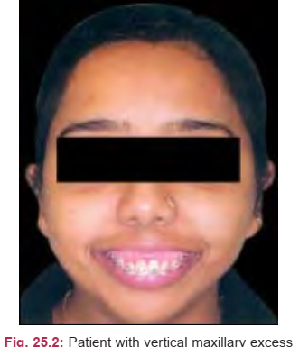
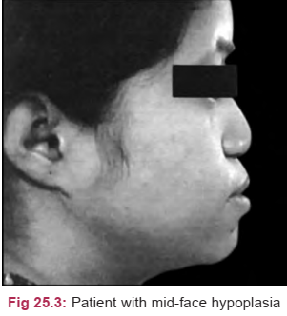

Slide 9
INDICATION FOR ORTHOGNATHIC SURGERY
ABNORMALITIES OF THE MAXILLARY BASE
Maxillary Retrognathism
Maxillary base may be posteriorly placed or may be too small in all dimensions There is a collapse of the normal mid-face supporting structures.
Maxillary Asymmetry
When the maxillary base is asymmetric in length and width, e.g. hemifacial microsomia.
Lateromaxillism may occur when a normal maxillary base is positioned laterally

Slide 10
INDICATION FOR ORTHOGNATHIC SURGERY
ABNORMALITIES OF THE MANDIBULAR BASE
Mandibular Prognathism It could either be that the mandible is too large in all dimensions or that the base of the body is positioned anteriorly
Excess mandibular bone causes protrusion of the lower jaw beyond the normal alignment with the upper jaw; with a resultant Class III malocclusion.

Slide 11
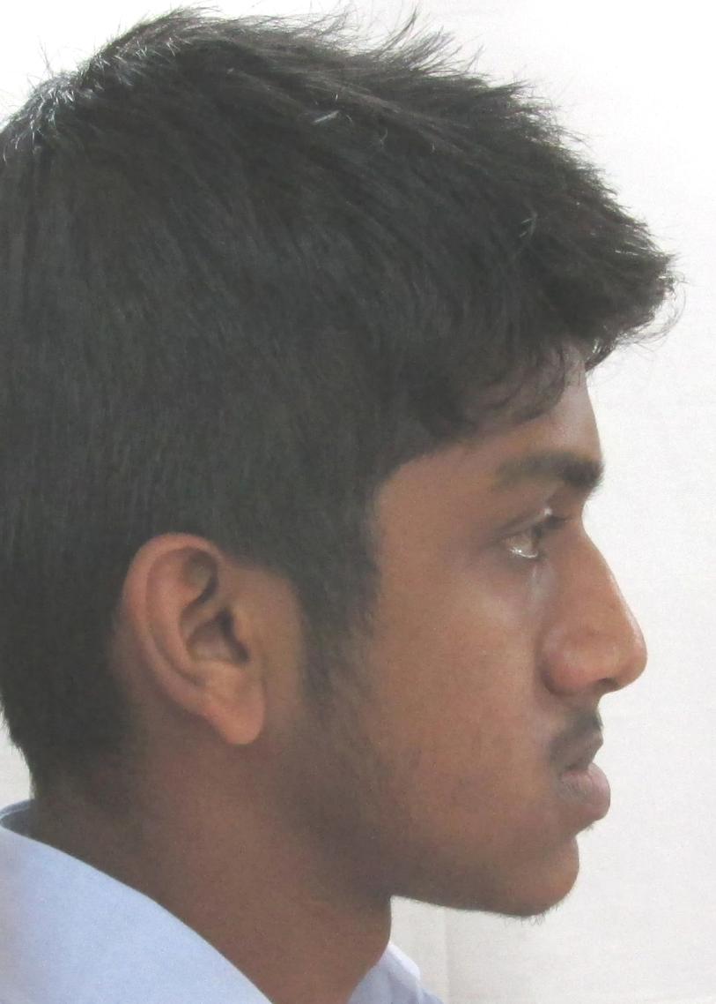
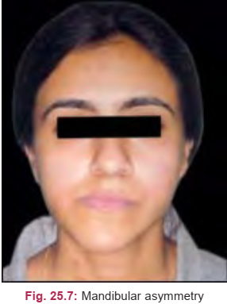

Slide 12
INDICATION FOR ORTHOGNATHIC SURGERY
ABNORMALITIES OF THE MANDIBULAR BASE
Mandibular Asymmetry The two halves of the base of the mandible have unequal dimensions
This may be seen in patients with hemimandibular hyperplasia, hemimandibular hypertrophy.
Both halves of the base of the mandible may have equal dimensions but may be shifted to one side; this is called lateromandibulism

Slide 13
INDICATION FOR ORTHOGNATHIC SURGERY
ABNORMALITIES OF THE CHIN The chin should be evaluated separately from the mandible.
The chin prominence includes both bone and soft tissue that may require separate surgical management. Common abnormalities are: Macrogenia Microgenia

Slide 14
PLANNING ORTHOGNATHIC SURGERY
CLINICAL EXAMINATION This should include a general medical examination to rule out any systemic disorders, e.g. acromegaly.
Local oral examination should include overall dental health.
Any pulpal or periodontal infections should be eradicated before surgery.
The TMJ is assessed for any pre-existing pathology, e.g. clicking, locking, tenderness, deviation, etc.

Slide 15
PLANNING ORTHOGNATHIC SURGERY
RADIOLOGICAL EXAMINATION A complete dental and skeletal radiographic survey can be done with an OPG, lateral cephalogram, frontal xray, submentovertex etc
The X-ray will also aid in the determination of the stability of teeth in the supporting tissue and their ability to withstand the stresses of fixation devices and immobilization.

Slide 16
PLANNING ORTHOGNATHIC SURGERY
RADIOLOGICAL EXAMINATION Any impacted/embedded or ectopic teeth, which may come in the line of the osteotomy cut, should be preferably extracted 6 months prior to surgery.
The flare of the rami is assessed on a submentovertex view when intraoral approach for ramus osteotomy is planned

Slide 17
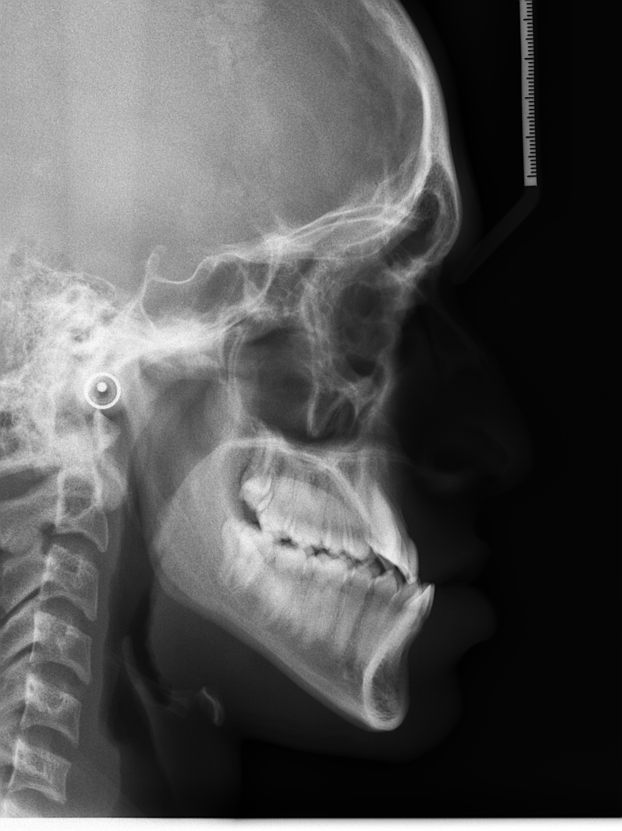
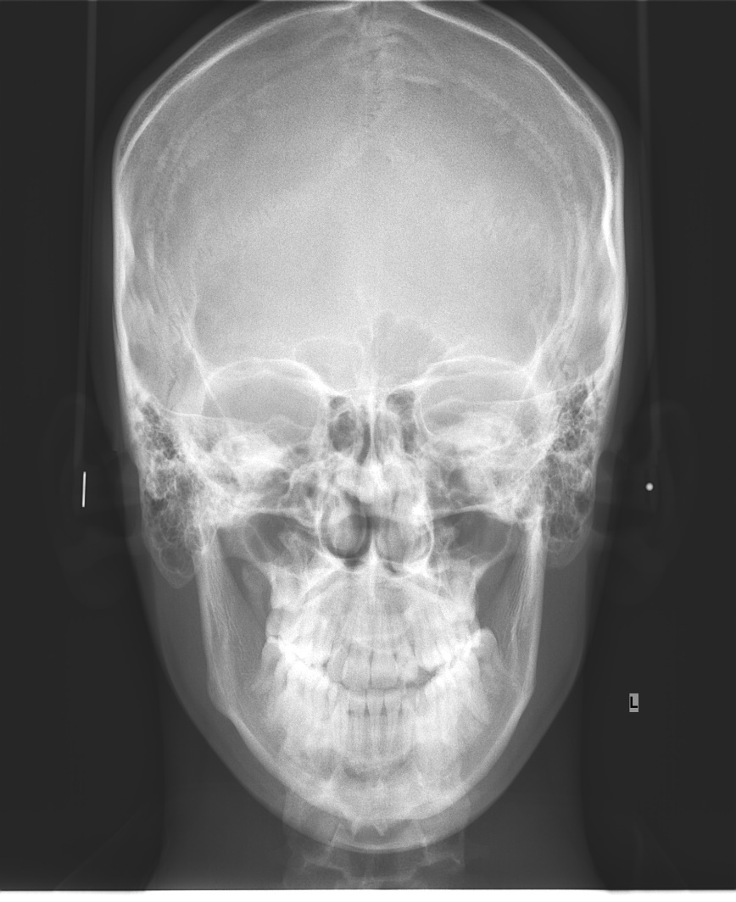

Slide 18
PLANNING ORTHOGNATHIC SURGERY
CEPHALOMETRIC EVALUATION
This is essential for preoperative evaluation of all patients regardless of the type of deformity.
Lateral cephalogram and/or anteroposterior cephalogram in asymmetry cases is most helpful in determining precisely the location of the deformity and in selecting the proper operative sites for surgical correction.
Soft tissue outline on the cephalogram is marked by painting barium on the midline of the patient’s face prior to shooting the radiograph.

Slide 19
PLANNING ORTHOGNATHIC SURGERY
STUDY MODELS Two sets of dental stone models are constructed from the patient’s impressions.
Bite registration is useful while mounting the models on an articulator.
They provide a permanent 3-D record of the dental and underlying skeletal structures.
They also present the various permutations of movement area involved that will need to be explored to correct the presenting facial and jaw disharmony.
A second articulated set is used as working models on which mock surgery is performed

Slide 20
PLANNING ORTHOGNATHIC SURGERY
MODEL SURGERY A surgical plan is decided upon and then the surgery is simulated on articulated working models.
The models are cut and repositioned in the desirable position and the segments secured in their new position with sticky wax.
The occlusion achieved is evaluated for stability and any modifications required noted.
Splints are then constructed which are of immense help during surgery.

Slide 21
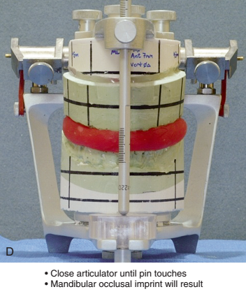
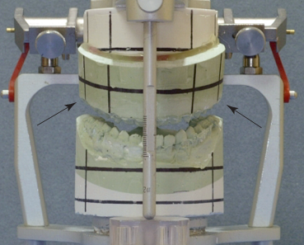

Slide 22
ORTHOGNATHIC SURGERIES
ANTEROPOSTERIOR CORRECTION Maxillary Surgery Advancement Le-Fort I downfracture and advancement is the preferred technique for maxillary retrognathism.
Retraction Retraction of a Le-Fort I segment is difficult because of the presence of the pterygomandibular plates and tuberosity.
Therefore anterior segmental osteotomy (Wassmund or Wunderer procedure or Cupar’s technique) after extraction of a premolar on either side is most commonly performed in maxillary prognathism cases.

Slide 23
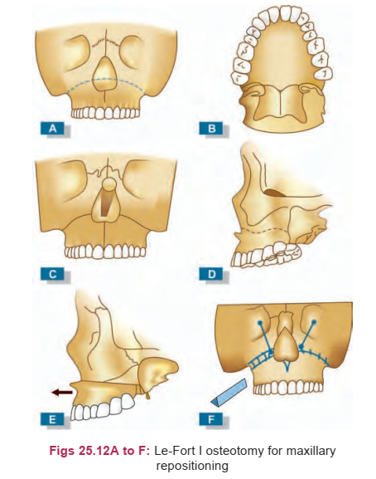
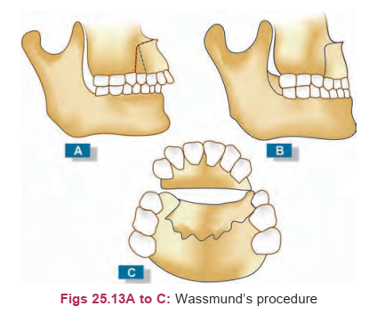

Slide 24
ORTHOGNATHIC SURGERIES
ANTEROPOSTERIOR CORRECTION Mandibular Surgery Advancement & Setback
Bilateral sagittal split osteotomy (BSSO) is currently the most preferred technique since it can be performed easily intraorally
Anterior segmental subapical osteotomy can be performed if only the alveolar segment needs to be advanced or setback without moving the chin-point.

Slide 25
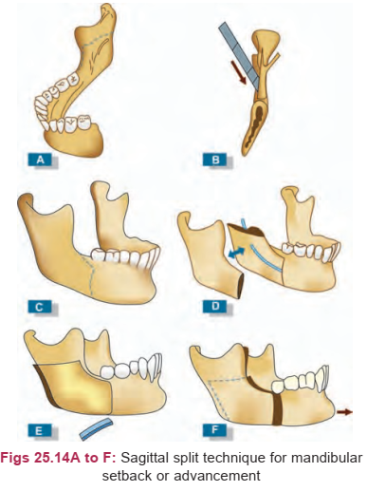
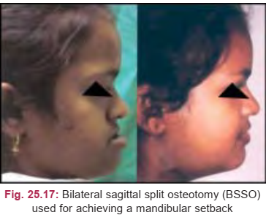

Slide 26
ORTHOGNATHIC SURGERIES
VERTICAL CORRECTION Maxillary Surgery Both superior positioning (for long face correction) and inferior positioning (for short face correction) can be performed by Le-Fort I down-fracture technique.
Inferior movements however is less stable and usually require insertion of bone
Mandibular Surgery Shortening of vertically excessive mandible should be done by inferior border osteotomy and chin augmentation horizontally.
Elongation of lower facial height can be done with BSSO, which rotates the mandible down and forward.

Slide 27
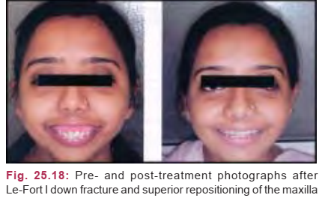

Slide 28
ORTHOGNATHIC SURGERIES
TRANSVERSE CORRECTION Maxillary Surgery Expansion of maxillary arch is usually performed in conjunction with Le-Fort I.
Bone graft is needed to fill the space created by lateral movement of the posterior segments.
If constriction of the arch is required, bone is removed from the osteotomy sites as determined by pre-surgical planning. Mandibular Surgery Because of the TMJs transverse corrections are difficult in mandible.
Anteriorly, extraction of a tooth and ostectomy can be performed to achieve constriction of the arch.
Expansion is better done by distraction osteogenesis rather than osteotomy.

Slide 29
ORTHOGNATHIC SURGERIES
SKELETAL OPEN-BITE CORRECTION (APERTOGNATHIA) Skeletal open-bite commonly occurs in long-face individuals who have vertical maxillary excess, antero-posteriorly deficient mandible with short ramus height.
Le-Fort I down-fracture and superior repositioning of the maxilla especially posteriorly best treat these patients.
The mandible autorotates upward and forward, which brings the chin anteriorly.
If lower teeth interfere with occlusion, they can be intruded orthodontically or anterior segmental surgery can be performed to depress this segment.

Slide 30
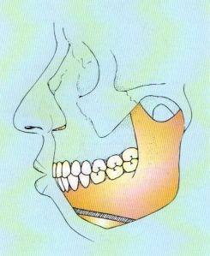
ORTHOGNATHIC SURGERIES
GENIOPLASTY The chin can be moved in all three planes after osteotomy or may be augmented by an onlay autograft or allograft.
Genioplasty is done to improve results of mandibular advancement or reduction or to correct asymmetry.

Slide 31
ORTHOGNATHIC SURGERIES
MALAR AUGMENTATION This is done through the mouth and can give added height and fullness to the cheeks.
An allograft is normally inserted after taking impression of face and making a face model into a pocket of soft tissue through an incision in the buccal vestibule which is stabilized with the help of suture, screw or wire.

Slide 32
Postsurgical Stabilization
Following surgery, the skeletal segments need to be immobilized and fixed.
Conventional methods of fixing include maxillomandibular fixation and transosseous wiring.
The maxillomandibular fixation is maintained for 1½–2 months in case of mandibular surgeries.
With Le Fort I surgeries, healing is rapid and hence jaws are mobilized earlier.

Slide 33
Postsurgical Orthodontics
The orthodontist removes the splint and the stabilizing archwire and places the working archwires.
The purpose of the stabilizing archwire is to hold the teeth rigidly, provide solid occlusion and prevent tooth movement.
This can be maintained for 4–5 weeks following which the splint is removed on the same day as the stabilizing archwire is removed and replaced with working archwires

Slide 34
DISTRACTION OSTEOGENESIS
The technique of bone formation under the inﬂuence of tensional stress is called distraction osteogenesis.
It involves progressive, controlled displacement of fractures created surgically and results in soft tissue and bone volume expansion simultaneously.
Distraction osteogenesis have increased the treatment alternatives in mild to severe anomalies of the craniofacial skeleton.

Slide 35
DISTRACTION OSTEOGENESIS
Role of Orthodontist
The orthodontist’s role in treating distraction osteogenesis undergoes three phases: 1. Planning the pretreatment for distraction and orthodontic preparation 2. Orthodontic and/or orthopedic therapy during distraction and consolidation 3. Postconsolidation orthodontic/orthopedic management

Slide 36
DISTRACTION OSTEOGENESIS
Predistraction Orthodontics Orthodontic appliances are chosen and treatment consistent with overall goals of distraction plan is begun.
The distraction stabilization appliances consist of a banded maxillary expansion appliance and a mandibular lingual holding arch, attached to two bands on each side.
The teeth should be moved to ideal positions relative to its basal bone such that the existing dental compensations do not compromise an ideal maxillomandibular skeletal relationship.

Slide 37
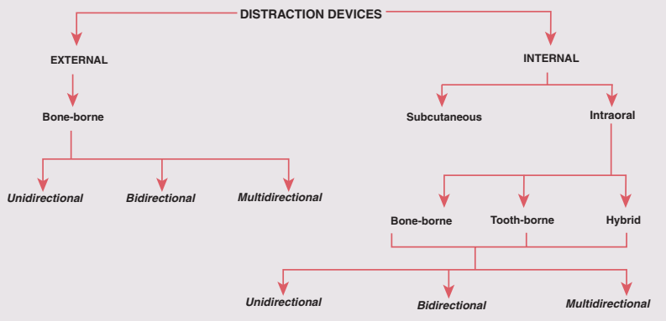

Slide 38
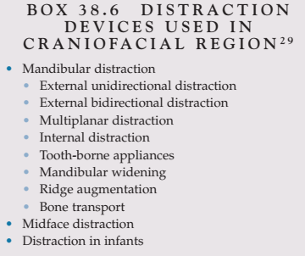
DISTRACTION OSTEOGENESIS
Distraction Procedure The distraction procedure involves three steps: 1. Mobilization of bones 2. Transport of mobilized bone in the required direction by means of the distraction of devices 3. Fixation of the healthy segments

Slide 39
DISTRACTION OSTEOGENESIS
Four inﬂuences that are presumed to affect the observed vector during the distraction phase are the following: 1. The unique biomechanical characteristics of the selected distraction device 2. Orientation of the distraction device to the mandibular anatomy 3. Neuromuscular inﬂuence 4. Externally exerted forces

Slide 40
DISTRACTION OSTEOGENESIS
Postdistraction Orthodontics After consolidation, the distraction device is removed and the tooth-bearing segment of the mandible derives its support from the new bone that was generated across the distraction gap.
Postdistraction orthodontics/ orthopedics is instituted at this time to accomplish the original treatment goals.
In growing children, the orthodontic treatment should consider future distraction or orthognathic surgery.

Slide 41
REFERENCES
Textbook of Orthodontics – Gurkeerat Singh, Jaypee Brothers; 2nd Edition
Orthodontics – The Art and Science, S.I Bhalajhi, AryaMedi Publishing; 7th Edition
Textbook of Orthodontics – Sridhar Premkumar, Elsevier; 1st Edition
Orthodontics: Diagnosis and Management of Malocclusion and Dentofacial Deformities – O.P Kharbanda, Elsevier; 1st Edition

Slide 42
Question & Answer Session

